Slide 1
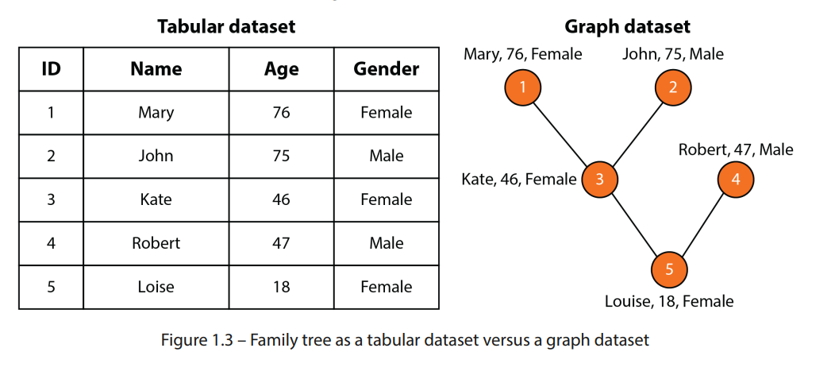
Graph Learning
Why Graph Learning?
Graph property’s
Directed graphs
Weighted graphs
Connected graphs
Types of graphs
Graph concept’s
Objects, Graph measures
Adjacency matrix
Breadth first search
Depth first search
Nodes & Deep-walk
Word2Vec
CBOW vs skip-gram
Skip-gram model
Deep walk and random walk

Slide 2
In this part we have to cover core basics of graph learning concepts such as graph centrality measures.

Slide 3
Collection of nodes(vertices)& edges.
Various domains:
Computer science - components of system interactions (simulations)
Physics - particles and their properties
Biology - metabolic pathways as network (interconnected)
Social science - relations between individual in community
Finance - analyse stock market, financial instruments
Engineering - transportation network, electrical power grids
It can be used in image processing, natural language processing
E.g. Information retrieval tasks.

Slide 4
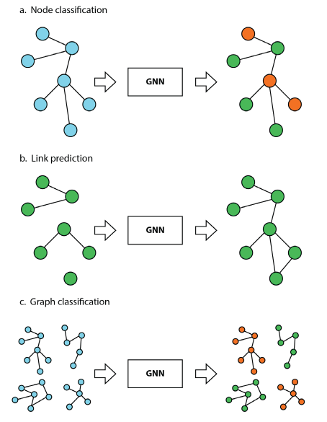
Why graph neural network?
Node classification: categorize(class) e.g. user or item or whatever based on character(params)
For example - model trained on label node with attribute predicts class of unlabeled nodes.
Link prediction: predicting missing links between pair of nodes
For example - people based on social network connection (friend recommendation)
Graph classification: categorize graph into categories.
For example - molecular structures(graph), predict their properties (drug design)
Graph generation: new graph based on desired properties,
For example - generating molecular structures for drug discovery
Applications such as recommender systems, traffic forecasting; different routes and transportation.

Slide 5
There are four techniques:
Graph signal processing: Social Network Analysis
Matrix factorization: Recommender Systems
Random walk: Web Page Ranking
Deep learning: (GCNs) for Node Classification
It’s important to note it’s not mutually exclusive and often overlap
Therefore, use hybrid model
(matrix factorization + deep learning)
(random walk + clustering)

Slide 6
Types of graphs
Directed graphs
Connected graphs
Weighted graphs “Minimum Cut Value of edges needed for graph disconnection”
Rooted trees
Connects all vertices via unique path
Represents hierarchical data structures like filesystems or XML documents.
Directed Acyclic (DAG).
No cycles or loops in directed graph.
Edges can only be traversed in specific direction.
Used to model dependencies between tasks or events.
Used in project management and job critical path computation.
Bipartite Graph
Divides node into two disjoint sets.
All edges connect nodes in different sets.
Used in mathematics and computer science to model relationships between objects.
E.g. buyers and sellers, employees and projects.

Slide 7
GRAPH CONCEPTS:
Graph objects: Degree
Directed Graph Degrees
Indegree deg− (): Number of edges pointing towards node.
Outdegree deg+ (): Number of edges starting from node.
Self-loop adds one to both indegree and outdegree.
Directed Graph Centrality
Quantifies importance of vertex/node.
Identifies key nodes based on connectivity.
Influences information flow/interactions.
Degree centrality = influence networks
Closeness centrality = quickly reach other networks
Betweenness centrality = bridge between networks

Slide 8
Degree centrality use case:
Social networks:
High degree centrality - high connections Influencer or popular node.
Transportation networks:
Important junctions/hubs for multiple routes coverages
Citation networks:
Represent papers/authors cite frequency

Slide 9
Social Network Analysis for Recommendation Systems
Targeting high-degree centrality nodes for recommendations.
Nodes likely to significantly influencer information spread or behavior

Slide 10
Closeness Centrality use case:
Social networks:
Nodes Facilitate Information Spread
Transportation networks:
Efficient transportation hubs logistics
Communication network:
Nodes disseminate information/Messages to other nodes

Slide 11
Disease Spread Model
High closeness centrality nodes indicate disease transmission.
Individual’s proximity and ease of interaction influence transmission.

Slide 12
Betweenness centrality use case:
Infrastructure Networks
Maintains connectivity and resilience for transportation / power grids
Social Networks:
Connectors, Connect different social groups/communities
collaboration networks:
Facilitates collaborations between disconnected groups

Slide 13
Density in Graphs
Measures connectedness of a graph.
Ratio between actual and maximum edges.
High density indicates more information flow (more connected).
Example 6 edges, maximum possible - 7(7-1)/2 = 21
Therefore density = 6/21 → 0.2857
dense graph = 1, sparse graph = 0

Slide 14
Adjacency matrix representation 2D array.
It checks 2 nodes are connected at constant time operation.
Calculation between shortest path of 2 nodes.
It checks existence of edge.
Drawback
Nodes increase means Exponentially matrix increase (space complexity)

